Slide 1
ARTIFICIAL INTELLIGENCE CHESS ENGINE IN HASKELL
By,
Anish V Mahesh 2010A7PS021G
Nitin Singh 2010C6PS550G
Under the mentorship of Dr. A Baskar

Slide 2
OBJECTIVE
Simulate a real chess game as closely as possible
The Engine should play valid legal moves
Should include Castling, En-Passant and Pawn Promotion features too
Should implement AI algorithms to play intelligently

Slide 3
LIMITATIONS
Pawn always promotes to Queen
Evaluation function is trivial
For MiniMax and Alpha-Beta Searches, the whole game tree is generated at each step
Depth of 5 plies and more takes too much time
Does not include Timer functionalities

Slide 4
EVALUATION FUNCTION
Assigns each piece type a value
Aggregates the total value of each side on the board
White value minus Black Value
White – more positive, Black – more negative
What more can be added?

Slide 5
Pawn Advancement How far up the board has each pawn advanced. Reaching the opposite end is important because it promotes the pawn to a different piece.
Piece Mobility (separate for each type of piece) How many different spaces can the given piece move to?
Piece Threats (separate for each type of piece) How many of the opponent's pieces are threatened by attack? This includes checks (which is a threat on the king)
Piece Protects (separate for each type of piece) How many of your own piece are protecting the given piece to prevent it from being captured without repercussion?

Slide 6
BOARD REPRESENTATION
2D Matrix – 8 X 8
Each element in the matrix – a square
Square represented by tuple (x, y)
Each square either contains a Piece or is empty
Every operation goes through squares
Square centric as opposed to Piece centric

Slide 7
MOVES GENERATION
Generating all the legal moves
Legal – According to the rules of Chess and not involving any AI
Three step process
Empty Board Moves
Semi-Valid Moves
Valid Moves

Slide 8
SEARCHING
MiniMax Algorithm
Alpha-Beta Pruning

Slide 9
CHALLENGES FACED
Haskell
Purely Functional Programming Language
Change of thinking process from Imperative style to Functional
Implementing Alpha-Beta Search
Implementing Castling, En-Passant
Haskell does not allow global variables
Had to maintain and pass history
Intermediate functions to check validity

Slide 10
GRAPHICAL USER INTERFACE
The Chess Engine does not have its own Graphical User Interface (GUI) but is rather a console application that communicates with GUI XBoard.

Slide 11
XBOARD
XBoard is a graphical chessboard for the X Window System.
XBoard supports different chess protocols like Chess Engine Communication Protocol and Universal Chess Interface.
XBoard sends engine a set of standard commands in string format.

Slide 12
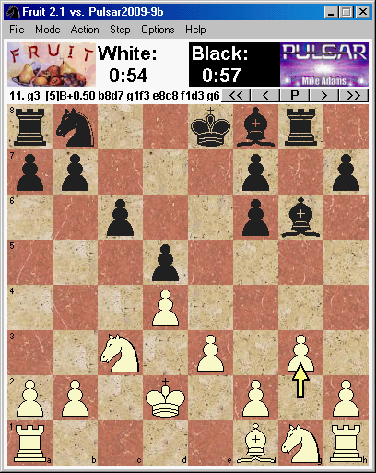

Slide 13
UNIVERSAL CHESS INTERFACE (UCI)
The Universal Chess Interface (UCI) is an open communication protocol that enables a chess program's engine to communicate with its user interface.
All communication is done via standard input and output with plain text commands.
Minimal Protocol

Slide 14
CHALLENGES FACED
Understanding the protocol
Input/output in Haskell
Everything happens in string format-wrapper functions
Understanding how to use parsers in Haskell

Slide 15
IMPROVEMENTS
Evaluation function is trivial- pawn advancement, piece mobility, piece threats, piece protects, Control of Center
Opening Moves and End games
Null Heuristic
Quiescence Search
Futility Pruning
Use of already explored tree

Slide 16
CONCLUSION
Chess Engine is able to play legal moves
Suggests best move
Capable of doing moves like Castling, En-passant, pawn promotion
Uses mini-max searching and alpha-beta pruning to think n-moves ahead
Chess engine uses Xboard and follows UCI protocol

Slide 17
THE END

